Slide 1

Healthcare Analytics with SQL
SUPARNA
MB30

Slide 2
Healthcare Data Analysis Using SQL
The main Objective about this project is to Extract meaningful insights from healthcare data, including patients, doctors, appointments, diagnoses, and treatments.
Data Integration – Using Joins to combine multiple tables
Advanced Analysis – Leveraging Subqueries & Window Functions
Performance Optimization – Utilizing Indexing & Query Optimization
Healthcare Metrics – Analyzing patient visits, doctor efficiency, treatment
So, the outcome of this project will be ,
Deeper insights into healthcare operations
Improved decision-making through data-driven analysis

Slide 3
Business Use Cases of Healthcare Data Analysis
Patient Management – Analyze demographics, medical history, and appointment trends.
Doctor Performance Evaluation – Measure doctor efficiency using diagnoses and treatment frequency.
Appointment Scheduling & Completion – Track booking trends, cancellations, and completion rates.
Medication Analysis – Identify the most commonly prescribed medicines based on diagnoses.
Revenue & Billing Analysis – Link appointments with billing data to analyze revenue trends.

Slide 4
SQL Tasks for Healthcare Data Analysis
1. Inner and Equi Joins
2. Left Join with Null Handling
3. Right Join and Aggregate Functions
4. Full Join for Overlapping Data
5. Window Functions (Ranking and Aggregation)
6. Conditional Expressions
7. Numeric and String Functions
8. Subqueries for Filtering
9. Date and Time Functions
10. Complex Joins and Aggregation

Slide 5

Importing Excel Data into SQL Workbench
Step 1: Convert Excel to CSV
Step 2: Create a Database
Step 3: Create a Table in SQL
Patients Table
Doctors Table
Appointments Table
Diagnoses Table
Medications Table
COMMAND TO LOAD DATA
Load CSV File into SQL Workbench
LOAD DATA INFILE 'C:/path_to_file.csv’
INTO TABLE table_name
FIELDS TERMINATED BY ',’
LINES TERMINATED BY '\n’
IGNORE 1 ROWS;

Slide 6
Inner and Equi Joins
Fetch details of all completed appointments, including: Patient's Name, Doctor's Name,Doctor’s Specialization

Slide 7
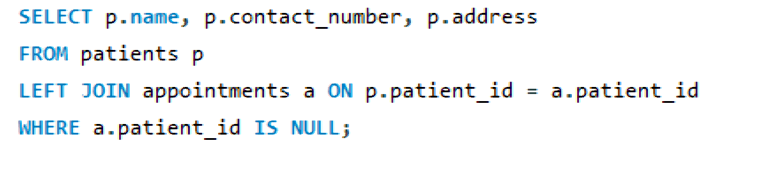
Left Join with Null Handling
Query to Retrieve all patients who have never had an appointment. Include their name, contact details, and address in the output.

Slide 8
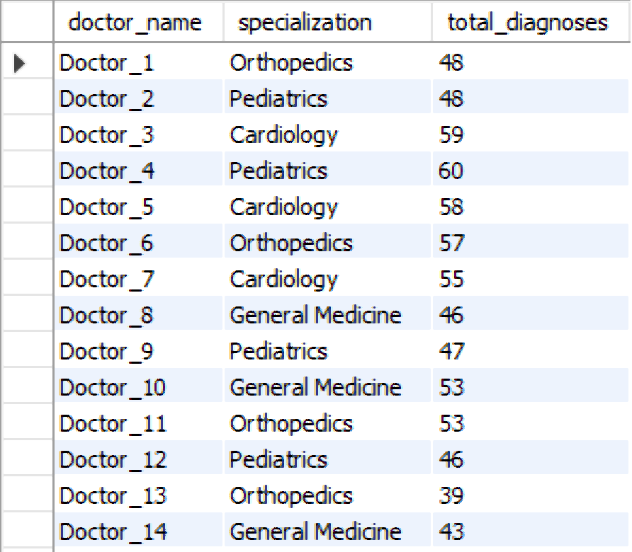
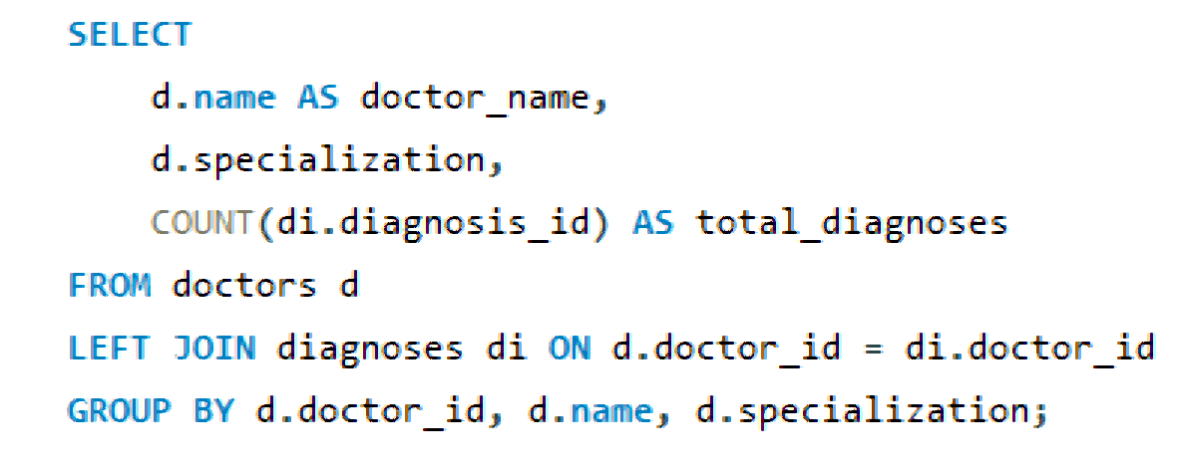
Right Join and Aggregate Functions
Find the total number of diagnoses for each doctor, including doctors who haven’t diagnosed any patients. Display the doctor’s name, specialization, and total diagnoses.

Slide 9
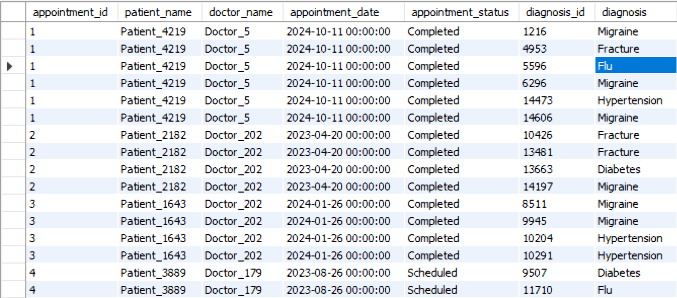
Full Join for Overlapping Data
Query to identify mismatches between the appointments and diagnoses tables. Include all appointments and diagnoses with their corresponding patient and doctor details.

Slide 10
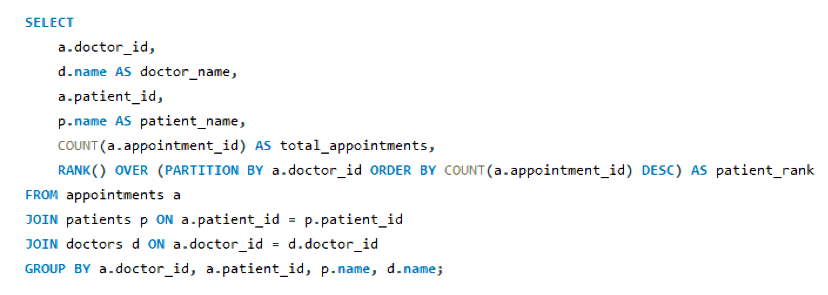
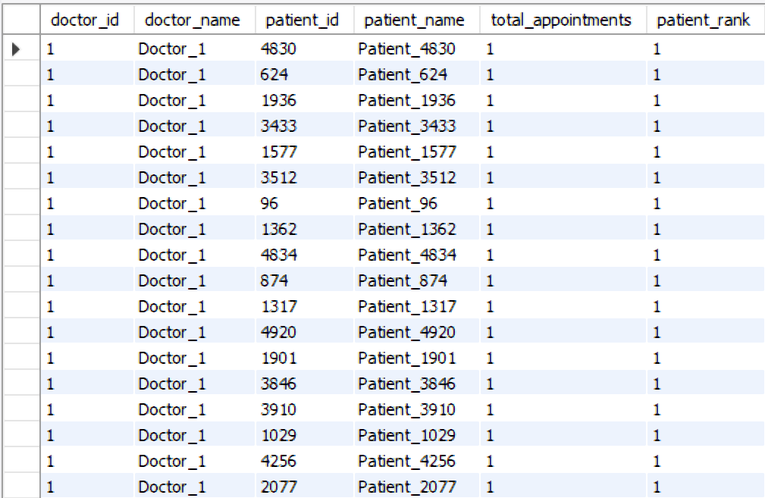
Window Functions (Ranking and Aggregation)
For each doctor, rank their patients based on the number of appointments in descending order.

Slide 11
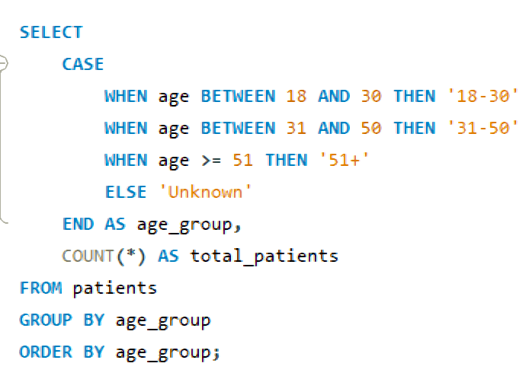
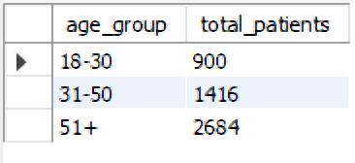
Conditional Expressions
Write a query to categorize patients by age group (e.g., 18-30, 31-50, 51+). Count the number of patients in each age group.

Slide 12
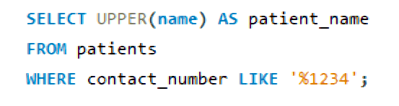

Numeric and String Functions
Retrieve a list of patients whose contact numbers end with "1234" and display their names in uppercase.

Slide 13
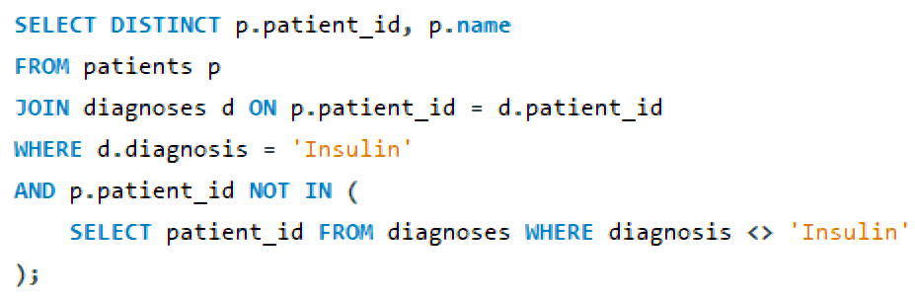
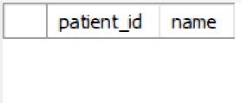
Subqueries for Filtering
Find patients who have only been prescribed "Insulin" in any of their diagnoses.

Slide 14
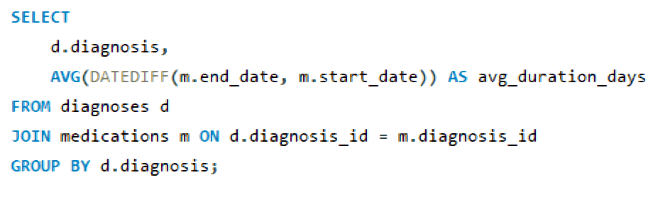
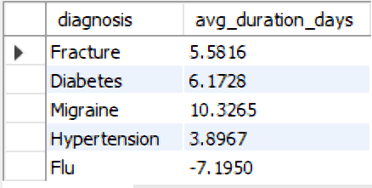
Date and Time Functions
Calculate the average duration (in days) for which medications are prescribed for each diagnosis.

Slide 15
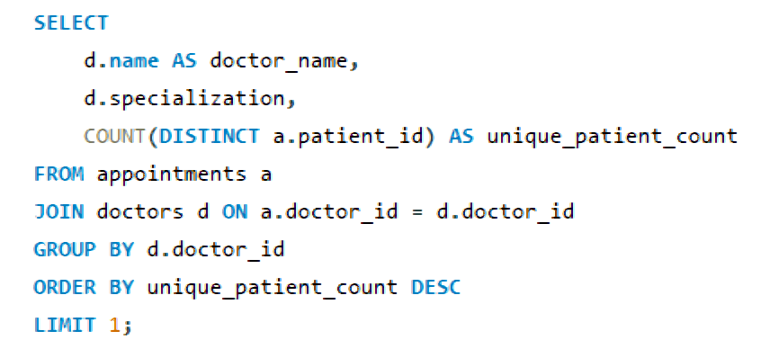

Complex Joins and Aggregation
Write a query to identify the doctor who has attended the most unique patients. Include the doctor’s name, specialization, and the count of unique patients.

Slide 16
Conclusion: Key Insights from Healthcare Data Analysis
Patient Insights – Extracted details on completed appointments and patient histories.
Doctor Performance – Evaluated diagnoses and treatment patterns for efficiency.
Appointment Analysis – Identified patients who never had appointments.
Segmentation & Ranking – Categorized patients into age groups and ranked doctors by patient visits.
Advanced SQL Techniques – Handled missing data and optimized filtering using subqueries.

Slide 17

THANK YOU

